Slide 1

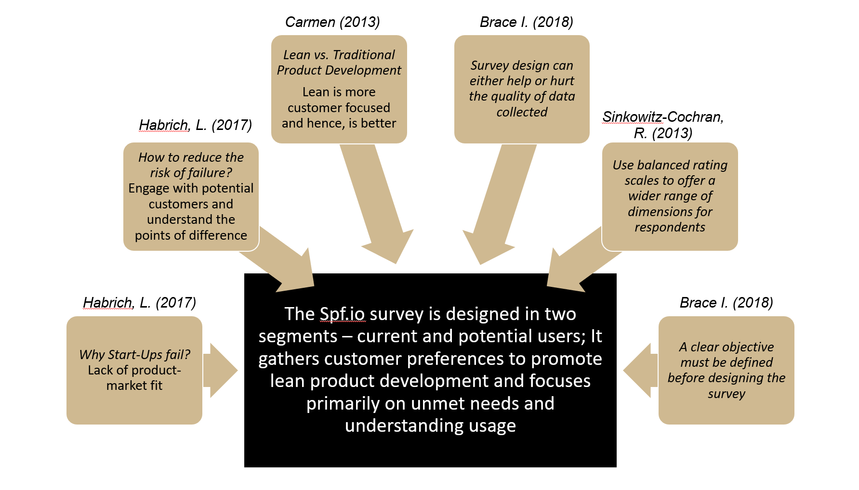











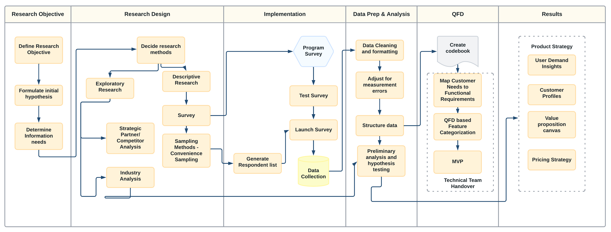
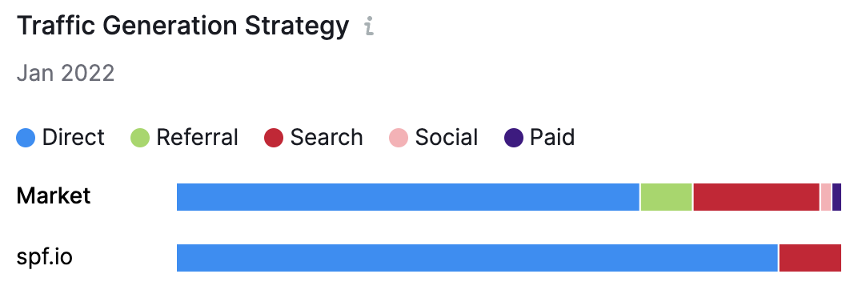
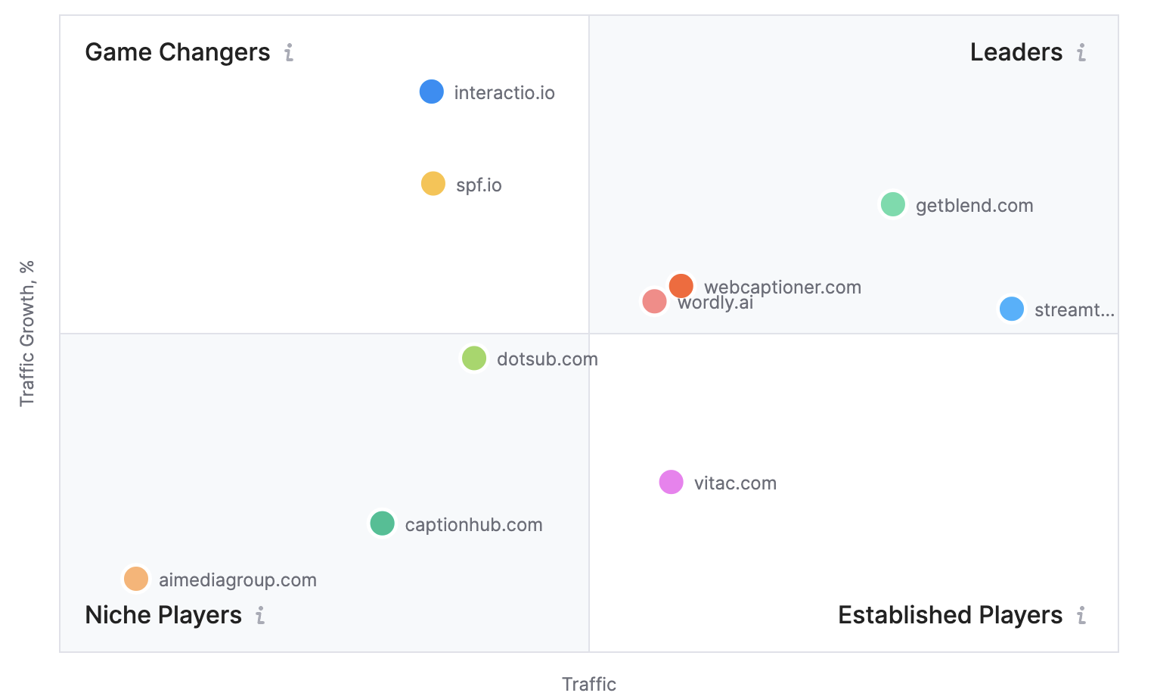
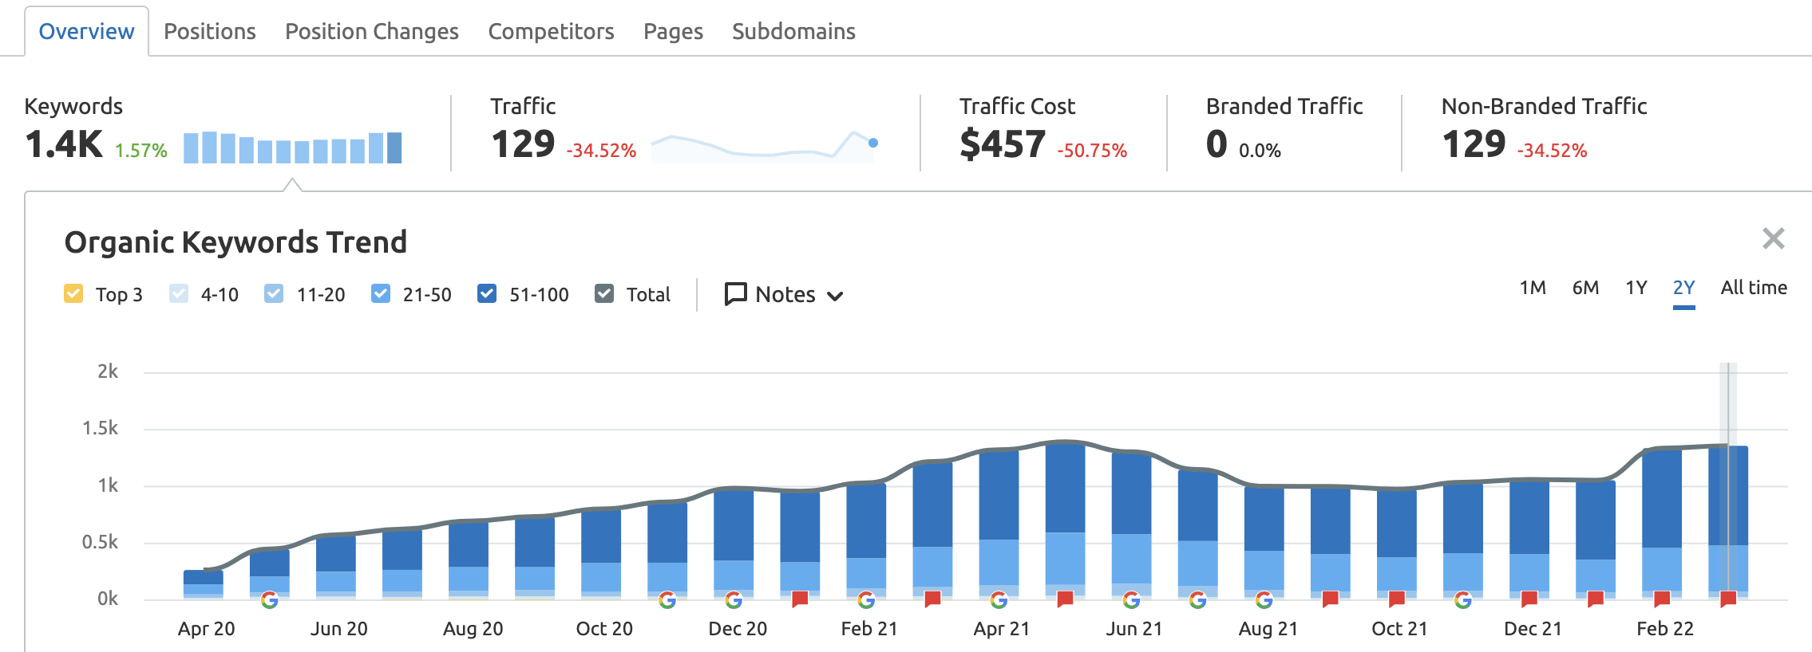




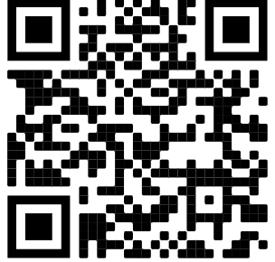
LITERATURE REVIEW
EXPECTED IMPACT
Reviewing several published papers helped us establish a base for the methodology. But our biggest challenge was the niche of clientele of our product. This fact required us to go detail hunting in order to realize our target customer.
User Demand Insights
Value Proposition Canvas
Customer Profiles
Competitor Analysis
Strategic Partners
Industry Analysis
Survey Results
Exploratory
Research
Pricing Bandwidth
Usage Frequency
Customer Placement
Understand and
Realize Potential
in the Market
Guides us to
Market Survey
Evaluating Product Market Fit and Determining A Go-To-Market Strategy For An Early Phase Technology Startup
Strategic Partnerships help us:
Label Significant Synergies
Drive Product Requirement
Promote the Product
Our offering:
Help client bridge the
gap in their services by introducing speech recognition, automatic translation, and real-time captioning services
Rahil Bansal, Kai Duan Chang, Piper Ann Doyle, Jnapika Mortha, Nalin Singh, Aman Srivastava, Matthew A. Lanham
Purdue University, Krannert School of Management
bansal63@purdue.edu; chang807@purdue.edu; doyle113@purdue.edu;jmortha@purdue.edu;singh816@purdue.edu;lanhamm@purdue.edu
CONCLUSIONS
ABSTRACT
The following are the most desired languages for translation and should be the focus
Narrowing in on the best target market is a problem in the technology industry. Our study evaluates product market fit and determines a go-to-market strategy for an early phase technology start-up to maximize launch success. Market research insights will be combined with exploratory data results to frame the go-to-market strategy.
METHODOLOGY
The methodology was carefully curated to incorporate the intersection of product and market requirements. The Research Objective helps us in understanding the basic requirements of the client with respect to the market needs. The Research Design and Implementation will guide the market survey outline and define competitor offerings, their pricing, and industry standards. The Data Prep and Analysis and QFD will help us gain significant insights from the survey outcome and in targeting our services to the right customer. An initial EDA would be performed on the gathered data to extract the insights. The results will be driving the user demand, customer profiles, our value propositions, and pricing strategy.
English
Spanish
Mandarin
Following is the most desired price model:
Key Competitors:
INTRODUCTION
Free to use
One-time Cost Model
Spf.io (pronounced spiffy-oh) is an all-in-one translation and accessibility platform that makes events and content accessible in many languages through captions, translations, transcriptions, and more. Spf.io is looking to launch a new segment of their business. Our study evaluates the best go-to-market strategy.
It is critical for any start-up to narrow in on their target market to increase the potential success of their product. Further, it is important to analyze customer preferences to determine which features most appeal to customers. Keeping this in mind, we developed customized surveys for each of our segments of interest – current users and potential users.
SEO : Investment in Paid referrals and Keywords
Move from Game Changers to Leaders
Goal 2: Analyze customer preferences
ACKNOWLEDGEMENTS
Demographics
Unmet Needs
We would like to thank Professor Matthew Lanham and our industry partner for this opportunity, their guidance, and support on this project.
Goal 1: Identify potential customers and narrow down the target segments
Current Usage
New Users
RESEARCH OBJECTIVES
Which product features are appealing to potential customers?
What price structure is appealing to customers?
Who is our company of interest’s competition?

